Slide 1
HTML
Hypertext Markup Language The Absolute Basics...

Slide 2
HyperText Markup Language
What is Hypertext?
Text containing links to more text. (see http://www.w3.org/WhatIs.html)
What is a markup language?
A way to embed formatting information within a text file by using tags
A way to describe the data or information (metadata) contained in a text file
What is a tag?
Method of identifying metadata within a document
What is metadata?
Data that describes data (ie GPS info in a digital picture)
Tags are used to describe the information

Slide 3
HyperText Markup Language
So: What is HyperText Markup Language?
A simple way of marking up documents so that they can shared (and understood) over networks (using HTTP - which uses TCP)
Why use it?
Simple
Lightweight (just plain text)
An easy way to send information both for users to see, and computers to interpret at the same time.
Tags?
Tags for presentation – www
Tags for interpretation – Semantic Web

Slide 4
HyperText Markup Language
Why learn it?? Why not just use some GUI??
HTML is a semantic* markup – understanding the underlying semantics will help you make good decisions about how machines will interpret your documents (e.g. search engines!)
If you do any web coding, you’ll want to know it
If you want to design or develop real-world web applications with a modern user interface, you’ll want to be fluent in it
Use markup tags to build document structure, e.g.
<p>This is a paragraph.</p>
*the tags can say something meaningful about the content they contain

Slide 5
HTML Versions
Current “HTML” versions:
XHTML 1.0
HTML 4.01
We will focus on XHTML & HTML 5
Work on HTML 5 is ongoing
Now a formal W3C Recommendation – as of Oct 2014
A working draft for 5.1 is already in the works most recent 8/31/15
browser support for its new features is hit or miss
...but it is much better - we will talk about as we go
XHTML is well supported
HTML 5

Slide 6
An HTML Document
^{<html>}
^{</html>}
^{<head>}
^{</head>}
^{<body>}
^{</body>}

Slide 7
Simple Example (HTML 5)
<!DOCTYPE HTML>
<html>
<head>
<title>
a title for the document
</title>
</head>
<body>
document content goes here
</body>
</html>

Slide 8
<head>…</head>
Contains document header information, e.g. the document title, file includes, meta information, page-level scripts and styles ...
Examples of markup found in the head:
<title>Document Title</title>
<style type=“text/css”>
<link href=“styles.css" rel="stylesheet" type="text/css"/>
<script type=“text/javascript”> some javascript here </script>
<meta http-equiv="Content-Type" content="text/html; charset=UTF-8"/>

Slide 9
<body>…</body>
Contains document content, e.g. paragraphs of text, images, captions, videos, interactive components, inline scripts ...
Examples of markup found in the body:
<h1>This is a First-level Heading</h1>
<h2>This is a Second-level Heading</h2>
<p>paragraph text</p>
<em>emphasized text</em>
<div id=“footer”>An arbitrary block named “footer”</div>
<img src=“figure1.jpg” width=“500” height=“300” alt=“Figure 1”/>
<ul> <li>bulleted list item 1</li> <li>bulleted list item 2</li> </ul>

Slide 10
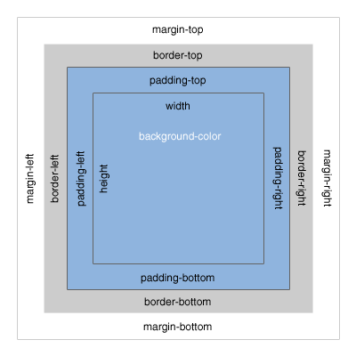
Markup Display Concepts
HTML Tags have three basic display states:
block
block elements can be thought of as a box with breaks before and after, e.g. paragraphs & headings
inline
inline elements flow with the content around them and do not break before and after, e.g. emphasized text
none
elements with display set to none will be hidden in the browser (though their content will still exist in the markup), e.g. scripts
CSS Box Model
2

Slide 11
Prior to lab 1 ...
Look over the XHTML tutorial at http://www.w3schools.com/html/html_xhtml.asp
– This covers the basic rules of XHTML which we will be using during Monday's lab.
Visit W3Schools XHTML tag reference, listed by function http://www.w3schools.com/tags/ref_byfunc.asp
look through the tag listing
ignore elements marked “deprecated” – they are not to be used
Look also at the W3Schools CSS reference http://www.w3schools.com/css/css_reference.asp

Slide 12
Software Overview
jEdit configuration, (alternative=Sublime)
Examine browser tools
Chrome
Web Developer's Toolbar

